Slide 1
Electronics 101
Some fundamentals, some applications and some (hopefully) useful tips
Jean-François Duval, MIT Media Lab, 11/11/2013

Slide 2
Units
Volt – V – Electric potential
Ex.: 24V battery pack
Ampere - A – Current.
Ex.: I’m passing 10mA through that LED
Do not confuse A (current) and Ah (charge). More details later.
Watt – W – Work
This Maxon motor can be used up to 200W (8.33A @ 24V)
Again, do not confuse with Wh (energy)
Farad - F – Capacitance
Ex.: Use a 100nF capacitor between +5V and GND
1 Farad is huge. Caps > 10000µF are not that common (except for Super Caps, but they are low voltage)
Ohm - Ω – Resistance
Ex.: Use a 10kΩ pull-up on that unused input pin
Henry - H – Inductance
Ex.: this switch mode power supply requires a 100µH inductor

Slide 3
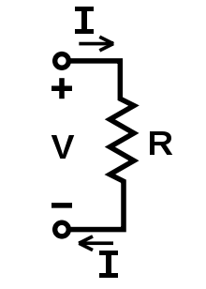
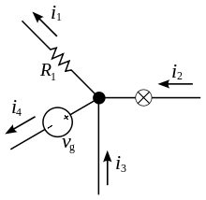
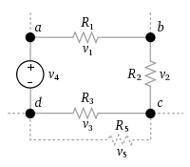
Ohm and kirchhoff
Ohm’s law: V = R*I
Kirchhoff's current law (KCL): The sum of currents in a network of conductors meeting at a point is zero.
Kirchhoff's voltage law (KVL): The voltage drop around a closed loop is 0.

Slide 4
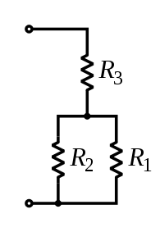
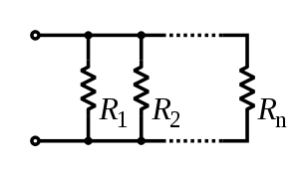
Series and Parallel Resistors
Series: R_{EQ} = R₁ + R₂ + … + R_{n}
Parallel: 1/R_{EQ} = 1/R₁ + 1/R₂ + … + 1/R_{n}

Slide 5
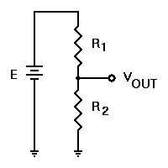
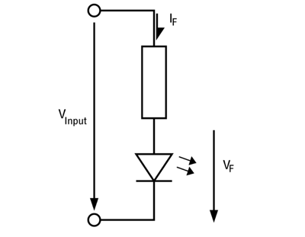
Resistive divider, LED current limiter
Voltage divider: V_{OUT} = V_{IN}*(R₂/(R₁ + R₂))
Ex.: 3.3V supply, R₁ = 5kΩ, R₂ = 10kΩ. V_{OUT} = 3.3V*(10kΩ/(10kΩ+5kΩ)) = 2.2V
LED resistor: R = (V_{SUPPLY} – V_{LED})/I_{LED}
Ex.: 3.3V supply, 2V 2mA LED: R = (3.3V – 2V)/2mA = 650Ω

Slide 6
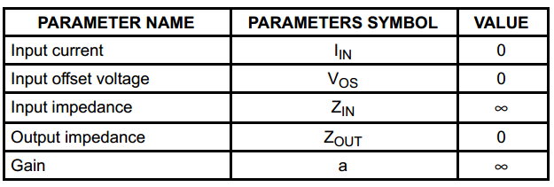
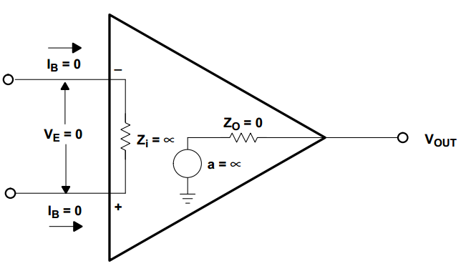
Operational Amplifier
Best reference: “Op Amps For Everyone” by Ron Mancini (TI) (http://www.ti.com/lit/an/slod006b/slod006b.pdf)
The Ideal Op Amp Assumptions:

Slide 7
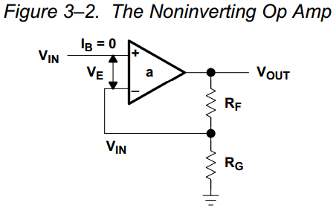
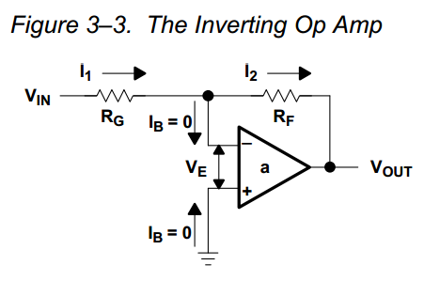
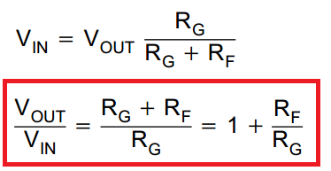
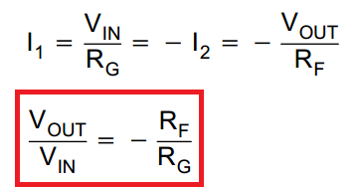
Operational Amplifier (2)

Slide 8
Operational Amplifier (3)
Op amps can be used for/in/as:
Active filters
Oscillators
Inverting or non-inverting amplifier
Precision rectifier
Integrator
Trans-impedance amplifier (ex.: for photodiodes)
PID loops used to be done only with op amps and passive components

Slide 9
Operational Amplifier (4)
What to be aware of:
Not all op amps are rail-to-rail. Many references advertised as rail-to-rail are only r-r on the output. Read the specs carefully.
Always make sure that your op amp is qualified for the voltage of your system (Is it single supply? Are you trying to use a 5V op amp in a 24V system?)
Bandwidth is one thing, slew-rate is another. It’s especially important to look at the SR if you use square waves.
Ex.: 20kHz sine wave, G=1, V_{peak} = 5V: SR_{MAX} = 2*pi*f*V_{peak} = 628e3 = 0.63V/µs

Slide 10
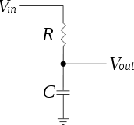
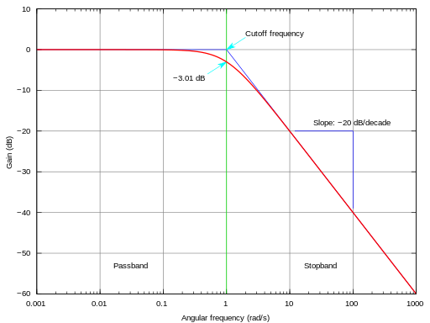
Passive filters
Low pass filter:
fc = 1/(2*pi*R*C)
R = 1k, C = 100nF, fc = ?
fc = 1.59kHz
At f=1.59kHz, the gain is -3dB (0.707)
0.707? G = 10^(G_{dB}/20) = 10^(-3dB/20) = 0.707
Need a high-pass? Swap R & C
For better performances, look at active filters (filters with an op amp)

Slide 11
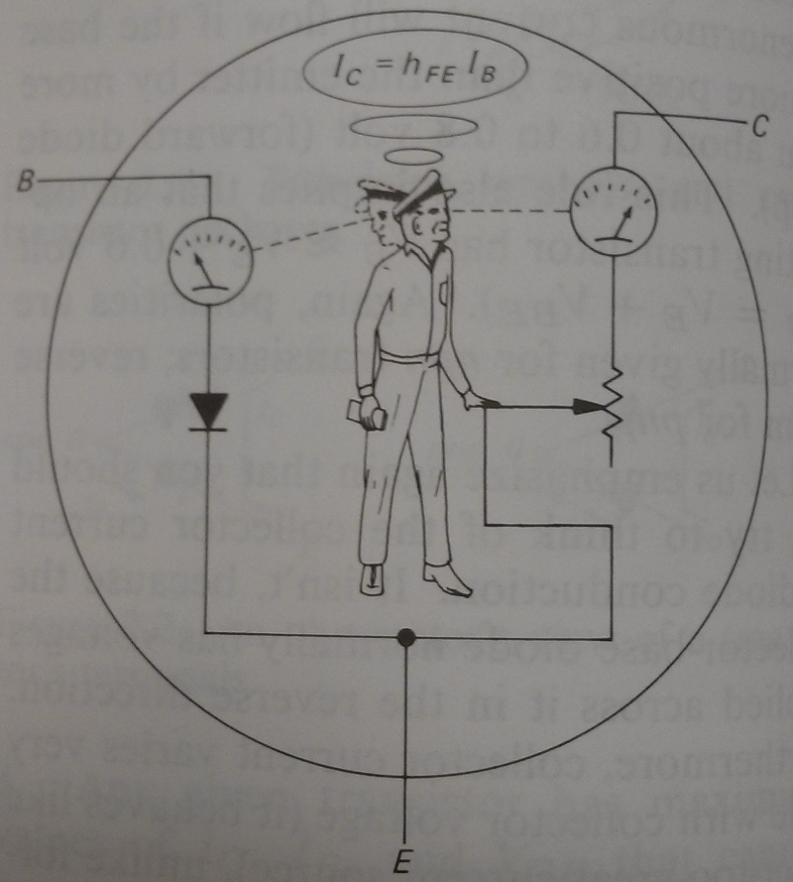
BJT Basics
Current controlled device
The Collector Current is proportional to the Base current.
Can be used in the linear region, but nowadays we mostly use it as a switch
Power LED and 2N2222 example
PNP
NPN

Slide 12
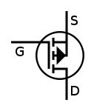
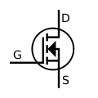
MOSFET basics
Voltage controlled device
Can be used in linear mode, but mostly used for switching applications
When you apply a sufficient voltage to the gate (Vgs), the channel opens
An open channel is like a tiny resistor
Power LED example
P-Channel
N-Channel

Slide 13
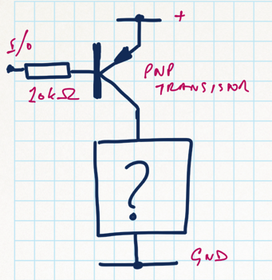
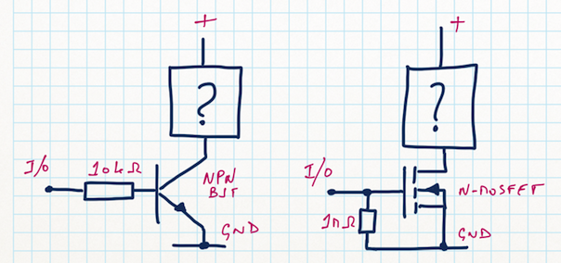
High-side vs low side switch
General rule:
P-CH MOSFET or PNP BJT: High-Side
N-CH MOSFET or NPN: Low-Side

Slide 14
MOSFET, BJT or Relay?
There is no general rule here, but always think about those factors:
If you use PWM, forget about relays
Some MOSFET require a Gate voltage higher than logic power supplies
Old power BJT transistors have really low gain (can be as low as 10). In that case, the base current is non negligible.
Relays are isolated
To drive most (if not all) relays you’ll need a transistor
For low-power stuff, a small logic-gate MOSFET can be used most of the time

Slide 15
Voltage regulators
Two main categories: linear or switching (also known as SMPS or switchers)
Linear: there is a series pass element (usually a transistor). The “unwanted” voltage is converted to heat. Current out = current in.
Ex.: 12V in, 5V out 500mA. Vdrop = (12-5) = 7V. Pout = 2.5W, Pin = 6W. Efficiency: 42%, 3.5W to dissipate in heat.
LDO doesn’t mean lower power! It simply means that you can use it with a lower input voltage
Pros: cheap, small, easy, low noise. Cons: inefficient, generates lots of heat
Switching: a “switch” (usually a MOSFET) chops the input power. An inductor, a diode and a cap filter it. Power in = Power out. Theoretically 100% efficient.
Pros: efficient. Cons: usually bigger, more complex, noisier

Slide 16
Thermal
“My MOSFET is rated for 260A, why would I need a heatsink? I’m only drawing 30A…”
Let’s look at a real part, IRLB3813. Continuous current drain at 25˚C: 260A, R_{DS(ON)} max: 1.95mΩ, Thermal resistance Junction to Ambient (R_{TJA}): 62˚C/W
P = RI² = 1.95mΩ*(30A)² = 1.755W
T_{J} = T_{ambient} + P* R_{TJA} = 25˚C + 1.755W*62˚C/W = 133.8˚C. Don’t touch it.
For Americans: 272F
(and I’m not including the derating. If you switch it (PWM), the dynamic losses are usually >= static losses)
The same basic math applies to voltage regulators (to everything in fact…)

Slide 17
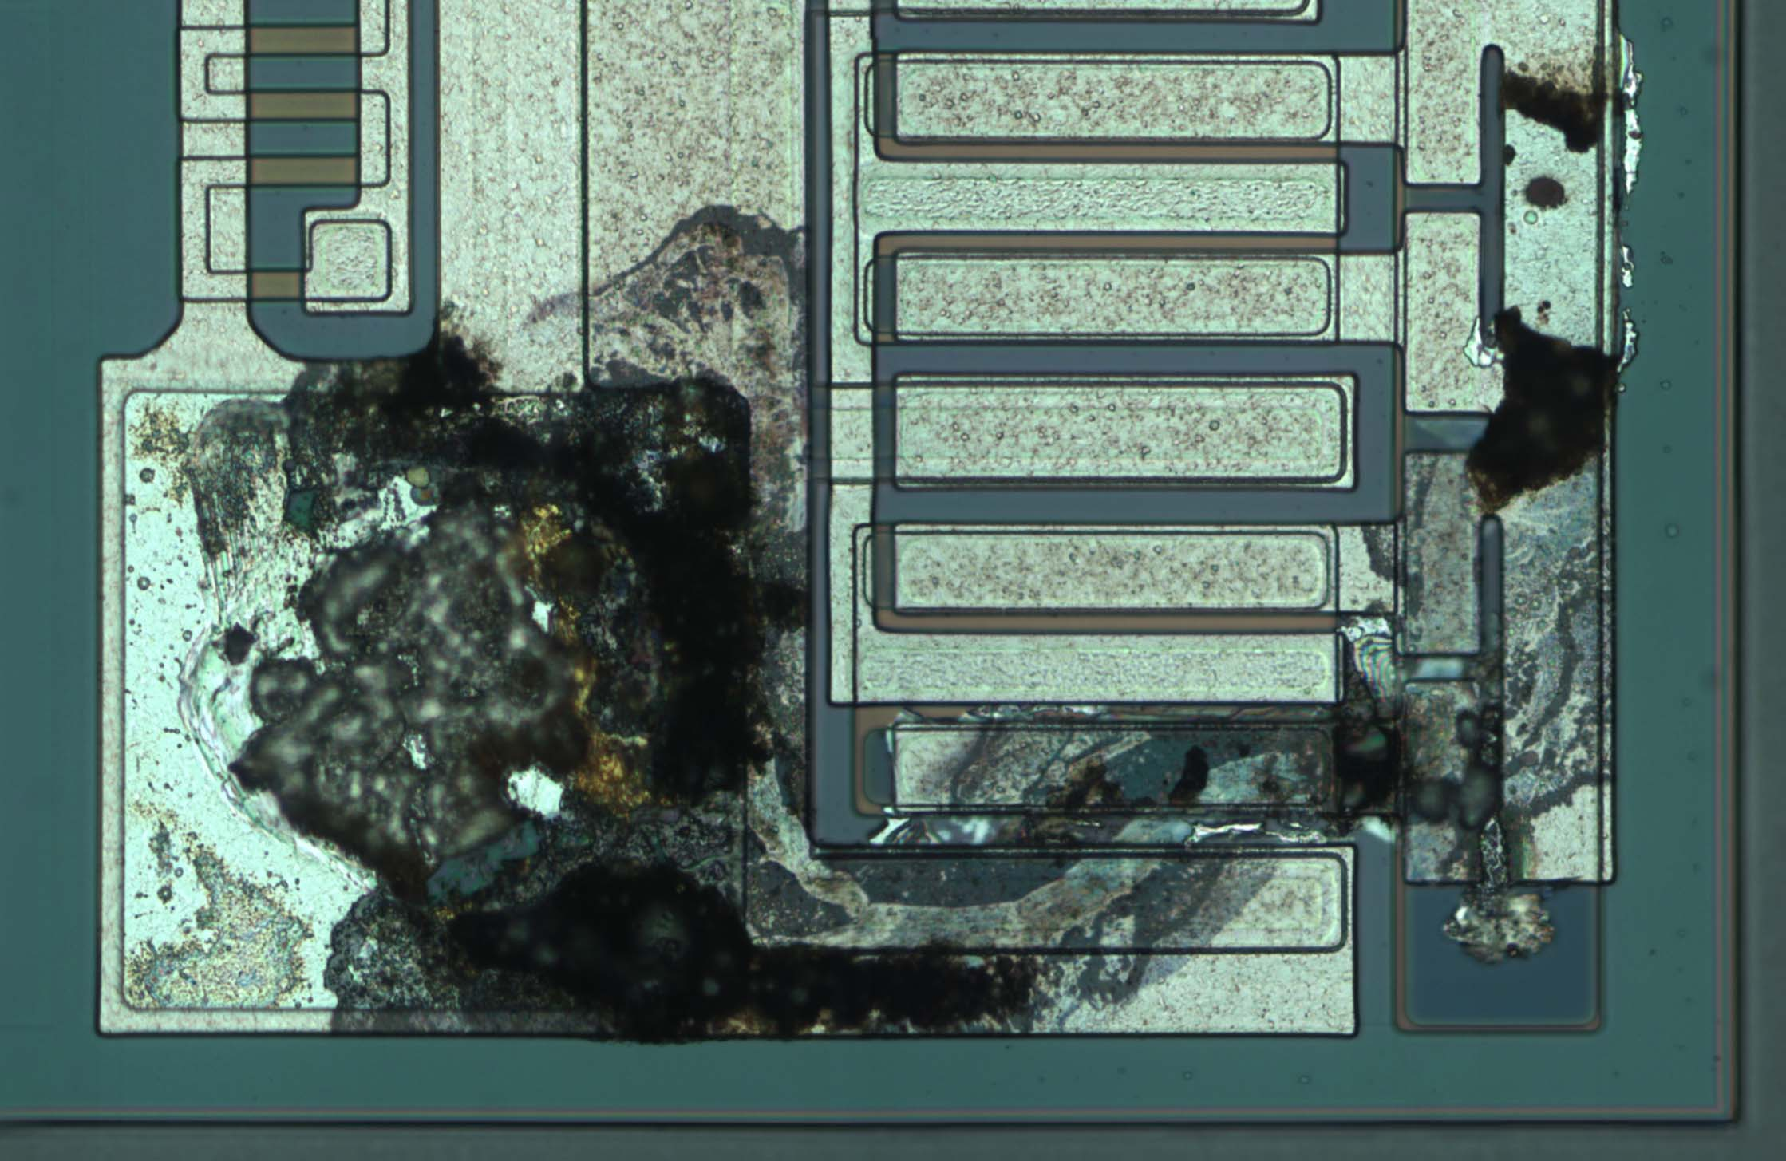
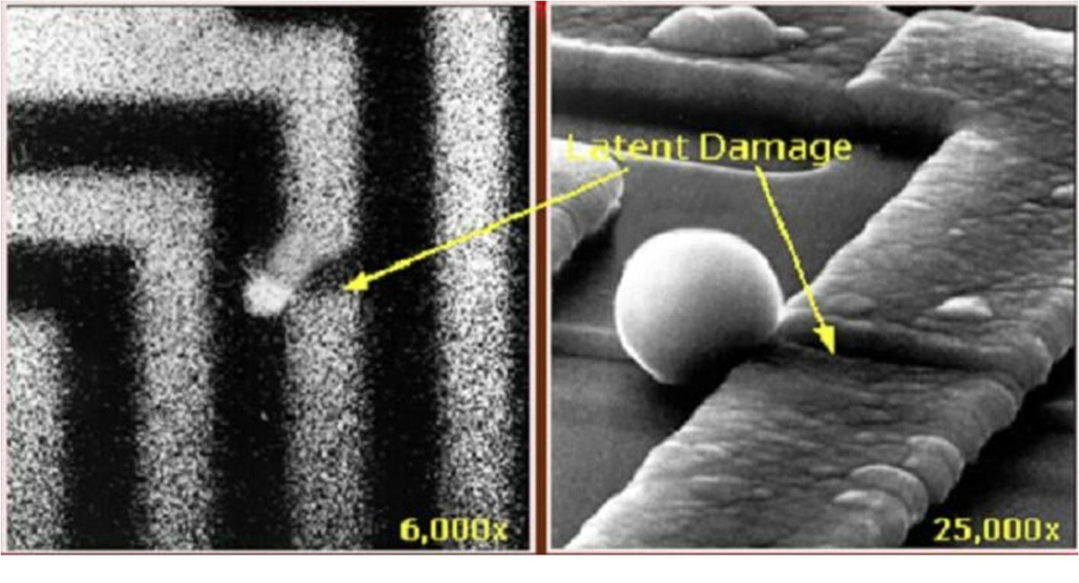
ESD
Discharge yourself before touching electronics
Always touch boards by the edges

Slide 18
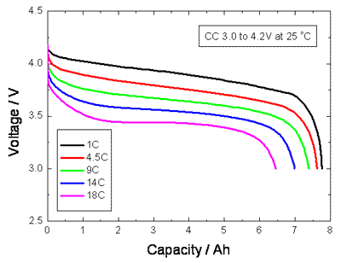
LiPO Battery
Let’s look at a real pack: “Turnigy 5000mAh 6S 20C Lipo Pack”
Each cell will be around 3.7V when fully charged
The minimum voltage is ~3V per cell
5000mAh means that you can draw 5A for an hour, or 10A for 30 minutes
Faster discharge = less energy
Never over discharge! (Search “lipo fire” on Youtube…)

Slide 19
Misc. Tips, breaking some myths
If you // LEDs, you need 1 resistor per LED (or string)
Always think about power dissipation
MOSFET’s gate doesn’t need current
It’s only true when you reach steady state. At every transition you need to charge/discharge a capacitor. To give you an idea, most gate driver ICs can pump a couple amps in the gate to make it switch as fast as possible!
Keep safety margins in your designs. A 24V MOSFET used to control a 24V motor WILL burn. Why? The inductive spikes can be twice as high as the supply voltage

Slide 20
Useful tools
LTSpice, free SPICE simulator: http://www.linear.com/designtools/software/
Filter Lab, active filter calculator: http://www.microchip.com/stellent/idcplg?IdcService=SS_GET_PAGE&nodeId=1406&dDocName=en010007&redirects=filterlab
To spec SMPS (and many other circuits), use TI WeBench (used to be NI WeBench): http://www.ti.com/lsds/ti/analog/webench/overview.page?DCMP=PPC_Google_TI&k_clickid=7e5739d4-74cf-8188-3be9-000020f0b88c&247SEM=

Slide 21
What else do you want to know?
How to search on Digikey?
How to design a PCB?
Communication buses?
…?

Slide 22
Sources
Wikipedia: en.wikipedia.org
Random Google Image
Jeelabs: http://jeelabs.org/2012/11/11/low-side-switching/

